Slide 1
Grammar and basics
Linking Words & Relative Clauses

Slide 2

Getting started: what do you already know? FANBOYS
Fill in Attendance: https://forms.office.com/e/9xF4TLDXZZ
Write one sentence each for the following linking words:
For
And
Nor
But
Or
Yet
So
Optional, but recommended: Make it a logical story.

Slide 3
Linking Words

Slide 4
Linking words
Words used to combine two sentences.
Many common examples, that aren’t a real problem for Dutch speakers:
And, or, but, so, because, for etc.
Today we’ll look at some less common ones, which could be a problem
Although/though/even though
Despite/in spite of
As, like
Who, which, that

Slide 5
Although / though / even though
These words are used to indicate a contradiction
Although it rained a lot, we enjoyed our holiday.
I didn’t get the the job, although I was qualified.
Instead of although you can also use though.
Even though is a stronger version, but works the same
Even though I was really tired, I couldn’t sleep.

Slide 6
Despite / in spite of
These expressions also indicate a contradiction
Despite the rain, we enjoyed our holiday.
I didn’t get the job, in spite of my qualifications.
Despite and in spite of are used the same. There is no meaningful difference in meaning
Despite being very tired, I couldn’t sleep.
In spite of being very tired, I couldn’t sleep.

Slide 7
The difference between although and despite
They have the same meaning, but are different grammatically
Although is followed by a short sentence with a verb in it
Although it rained a lot, we enjoyed our holiday.
Despite is followed by a phrase without a verb
Despite the rain, we enjoyed our holiday.
There can be an –ing form that looks like a verb, but isn’t
Despite being very tired, I couldn’t sleep.

Slide 8
Compare
Although he liked pizza, he never ate it.
Despite liking pizza, he never ate it.
Although liking pizza, he never ate it.
Despite he liked pizza, he never ate it.
Even though it was hot, she wore a coat.
In spite of the heat, she wore a coat.
Even though the heat, she wore a coat.
In spite of it was hot, she wore a coat.

Slide 9
As or like?
Like means ´similar to´ or ´the same as´
That house is like a palace.
I hate weather like this.
You can´t use as in sentences like these.
As means ´in the same way as´ when followed by a sentence with a verb
You should have done it as I showed you.

Slide 10
As or like?
When followed by a phrase (without a verb) as and like have different meanings.
I work as a taxi driver (= my job is taxi driver)
I always drive people to other places. I’m like a taxi driver (= I’m not really a taxi driver)
He performs as a clown at children’s parties (= he is a clown).
He acted like a clown in class today (= he is not a clown).

Slide 11
Relative Clauses

Slide 12
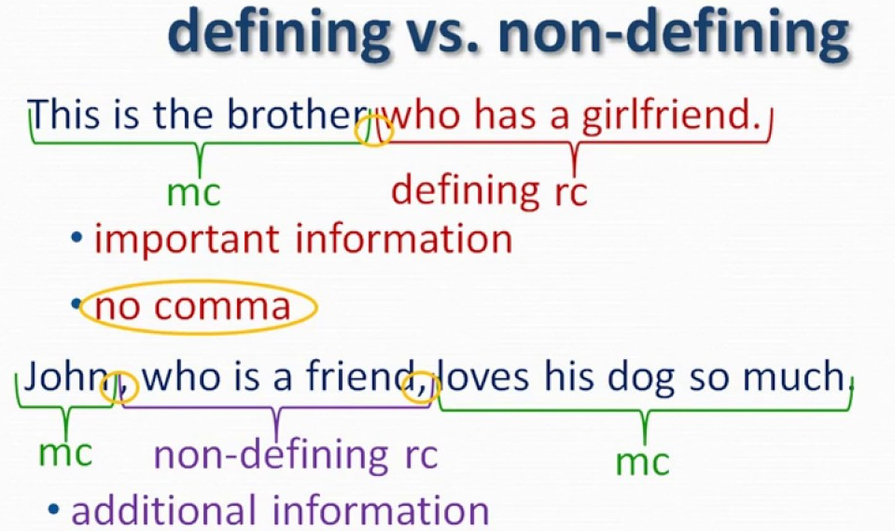
Defining
Non-defining
Essential information
One sentence
Extra information
Comma

Slide 13
Who, which or that?
Sometimes when combining two sentences you use one of these words to replace another word
My neighbour is a great guy. He has a lot of dogs →
My neighbour, who has a lot of dogs, is a great guy.
London is a beautiful city. It is the capital of England →
London, which is the capital of England, is a beautiful city
Who is used for people, which is used for things

Slide 14
Who, which or that?
Sometimes the part with who/which is essential to define who or what you are talking about. Then you can also use that.
The woman who/that lives next door is a doctor.
Where is the cheese which/that was in the fridge?
But that doesn’t work when the part with who/which is just some extra information
My neighbour, that has a lot of dogs, is a great guy.
London, that is the capital of England, is a beautiful city.

Slide 15
Who, which or that?
Which can also be used to refer back to a whole sentence
He wasn’t coming to the party, which really surprised me.
In summer we always go on holiday, which I really enjoy.
Dutch people tend to use that or what in sentences like these, but those can’t be used
He wasn’t coming to the party, that really surprised me.
In summer we always go on holiday, what I really enjoy.

Slide 16

Now You!
Printed Worksheet
OR
AI gamified experience

